Slide 1

HIGHCLOUD AIRLINES ANALYSIS
BY ANSHIKA RAI ASHWINI GANPAT AHER AGILE PADMALATHA NAMRATHA K RITIKA JAIN RUCHITHA R YELAMALA SUPRIYA
This Photo by Unknown Author is licensed under CC BY-NC

Slide 2
OBJECTIVE & Project Scope
TOOLS
DASHBOARDR
KPI’S
RECOMMENDATION
CONCLUSION
AGENDA

Slide 3

OBJECTIVE
To gain comprehensive understanding of “High cloud Airlines Data Analysis”.
This involved investigating Load factor, identifying top carrier names based on passengers' preferences, analyzing popular routes and exploring other key metrics.
The ultimate goal is to provide actionable recommendation that can enhance operational efficiency and profitability.

Slide 4
PROJECT SCOPE
By harnessing the power of data ‘High Cloud Airlines’ can gain valuable insights into various aspects such as,
Improved Load factor
Enhance Passenger Experience
Optimize resource allocation
Data driven decision making

Slide 5




PROJECT MANAGEMENT TOOLS
EXCEL
TABLEAU
POWERBI
MYSQL

Slide 6
Total Airlines 207
Total Country 106
Total City 1296
Total Passengers 187.02M
Total Operating Region 6
Load Factor 76.80%
Inception of the Data /KPI

Slide 7
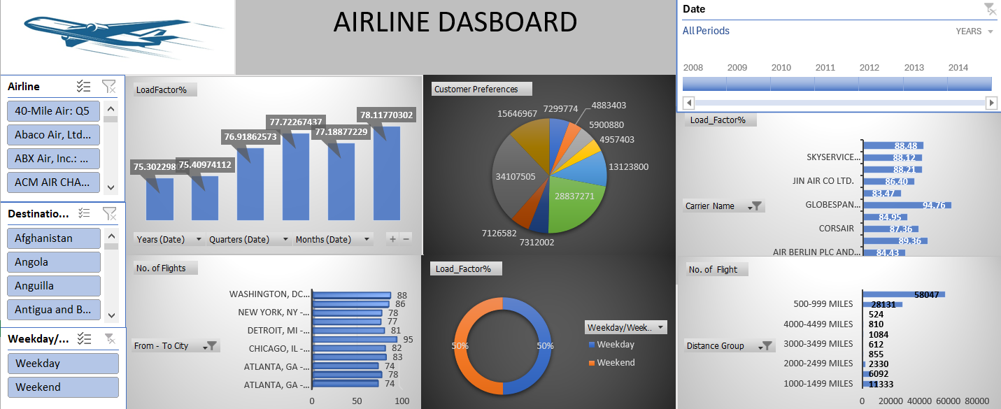
Excel Dashboard

Slide 8
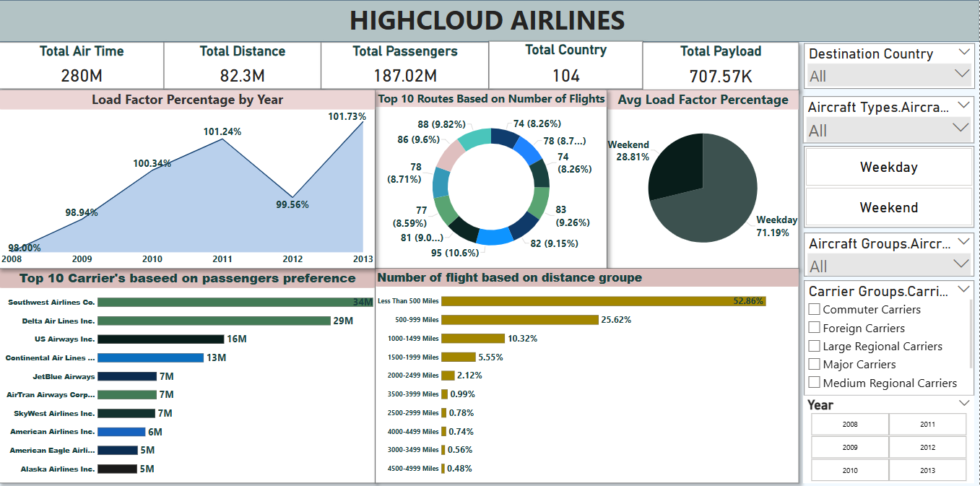
Power BI Dashboard

Slide 9
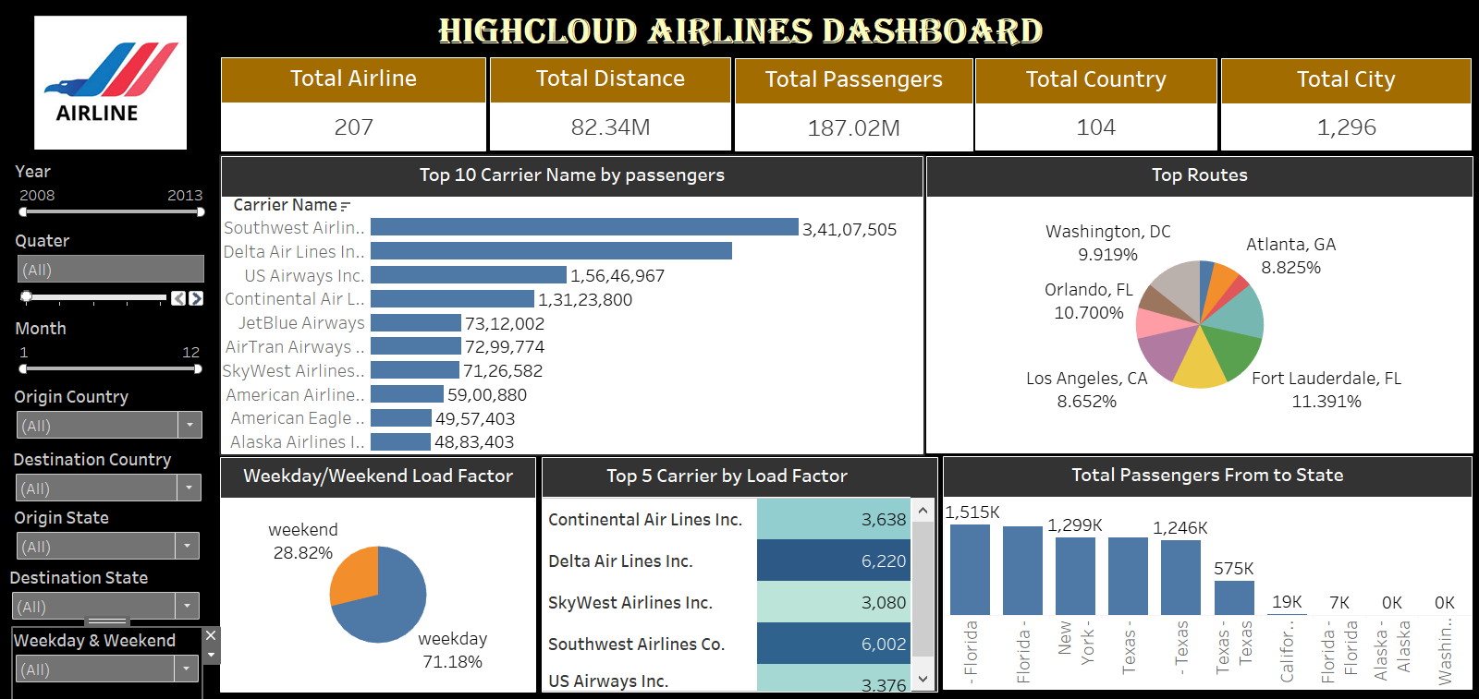
Tableau Dashboard

Slide 10
Optimize Flight Routes –Utilize insights from top routes and flights to optimize schedule and resource allocation
Strategic Carrier Partnership – Collaborate with top carriers to increase passenger Transportation
Enhance Load Factor –Leverage Load Factor Analysis to identify trends and implement strategies to increase efficiency .
Recommendation

Slide 11
Conclusion
The KPI’s offers a glimpse to improve and growth within.
By implementing these data-driven insights, High Cloud Airlines can enhance operational performance, improve customer satisfaction, and increase profitability, ensuring a competitive edge in the aviation industry.

Slide 12


